Slide 1

Dynamic Generation of Modular Industrial Plant Visualizations
Weekly Meeting 11
Miguel Romero Karam

Slide 2
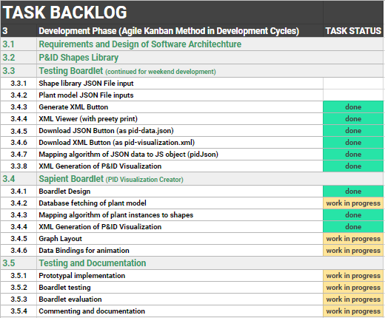
Task Backlog – Overview Overview of tasks: Week 11

Slide 3
Task Backlog – Overview Overview of tasks: Week 10

Slide 4
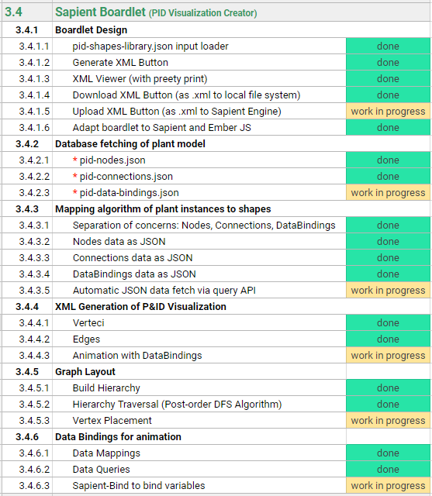
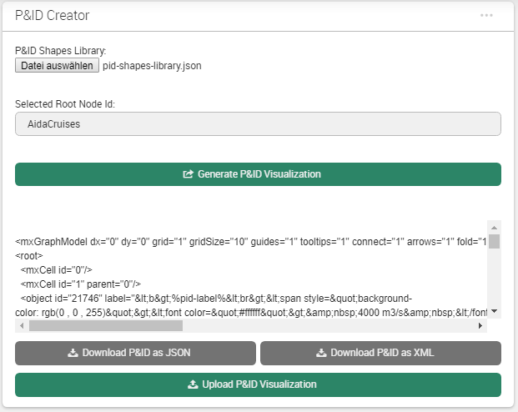
Sapient Boardlet Weekly Sprint 10

Slide 5
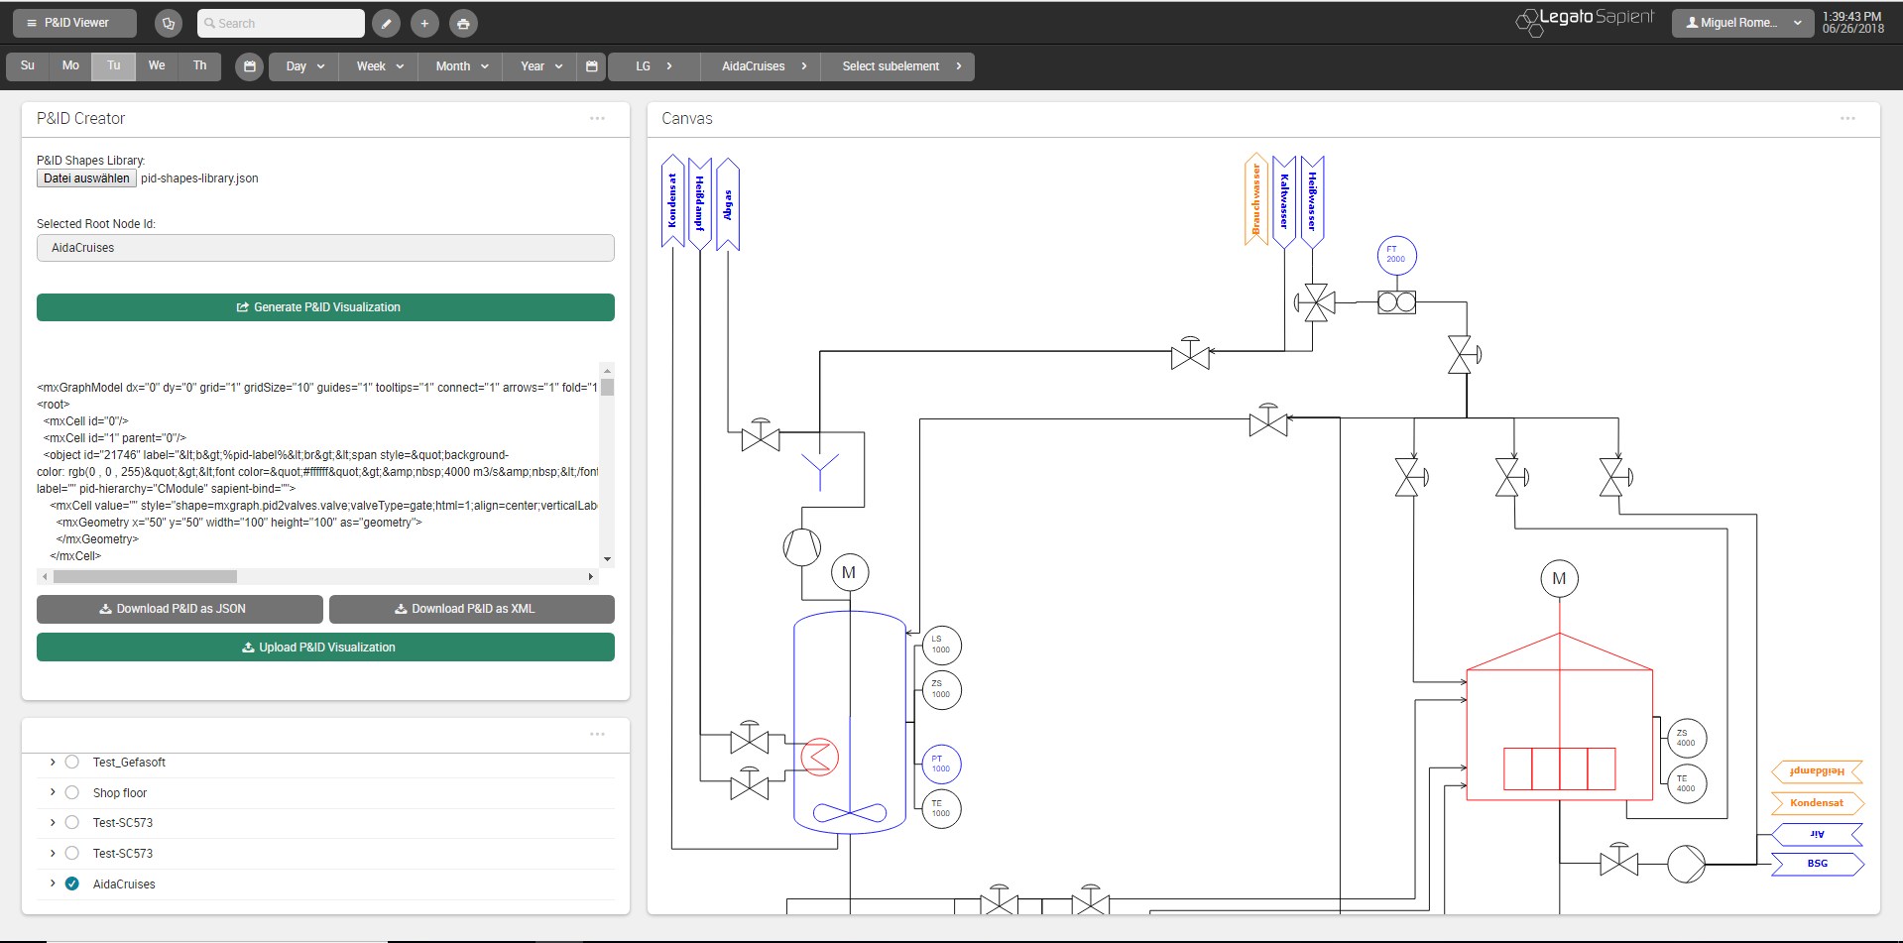
P&ID Viewer - Dashboard

Slide 6
Database Queries Overview: Data Map
l_nodes
prj_prc_pro_flows
p_values_current
id [PK] : Int
id [PK] : Int
id [PK] : Int
node_level : Int
node0 : Int
value_bool : Int
node_type : Int
node1 : Int
value_num : Double
parent : Int
port0 : Int
value_str : String
short_name : String
port1 : Int
p_values_config
value_date : Timestamp
name_0 : String
product : Int
time_stamp : Timestamp
name_1 : String
is_continuous : Boolean
id [PK] : Int
last_archive_id : Int
description_0 : String
rate_value : Int
connection : Int
last_update : Timestamp
description_1 : String
flow_type : String
value_type : Int
…
permissions : Int
value_format : Int
attr_jsonb : Jsonb
value_symbol: String
p_value_types
modelId : Int
prj_prc_visu_vertices
name_0: String
isaLevel : String
id [PK] : Int
name_1: String
id [PK] : Int
valPrefix : String
node : Int
…
name_0 : String
standingData: Array
shape_name : String
name_1 : String
opcUALevel : Int
is_instrument : Boolean
description_0 : String
opcUANamespaceName : String
pid_label : String
description_1 : String
opcUAAddressPrefix : String
pid_function : String
…
…
pid_number : String

Slide 7
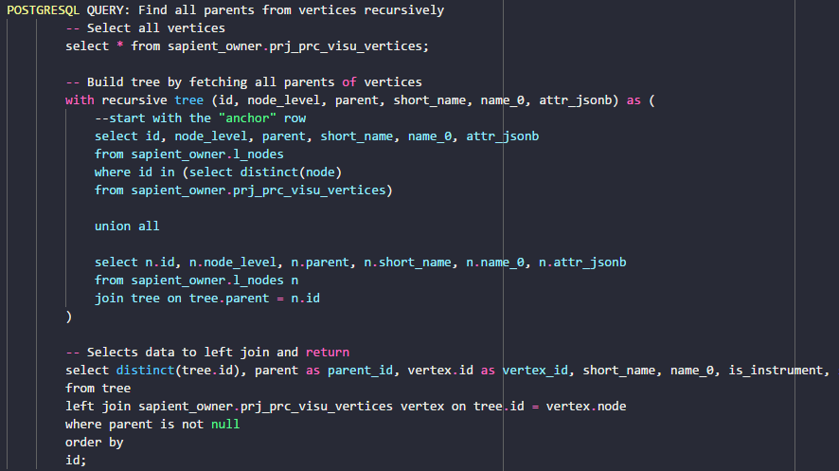
Database Queries Nodes Query - Problem
SQL- Query:
Complex SQL Query with LEFT JOIN not possible with getRecords options
Workaround with javascript:
2 distinct queries
Left Join Function in javascript on common attribute.
prj_prc_visu_vertices
l_nodes
id [PK] : Int
id [PK] : Int
node : Int
node_level : Int
shape_name : String
node_type : Int
is_instrument : Boolean
parent : Int
pid_label : String
short_name : String
pid_function : String
name_0 : String
pid_number : String
name_1 : String
description_0 : String
l_nodes
description_1 : String
Wanted Query Data
permissions : Int
attr_jsonb : Jsonb
visu_vertices
modelId : Int
isaLevel : String
valPrefix : String
standingData: Array
opcUALevel : Int
opcUANamespaceName : String
opcUAAddressPrefix : String
…
LEFT JOIN
ON tree.id = vertex.node

Slide 8
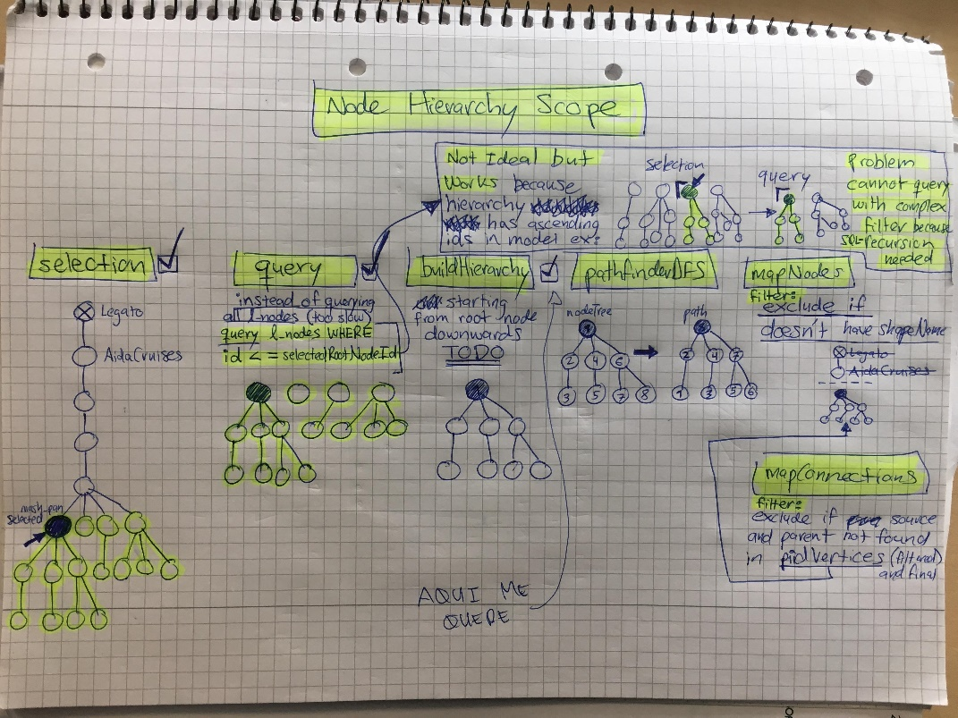
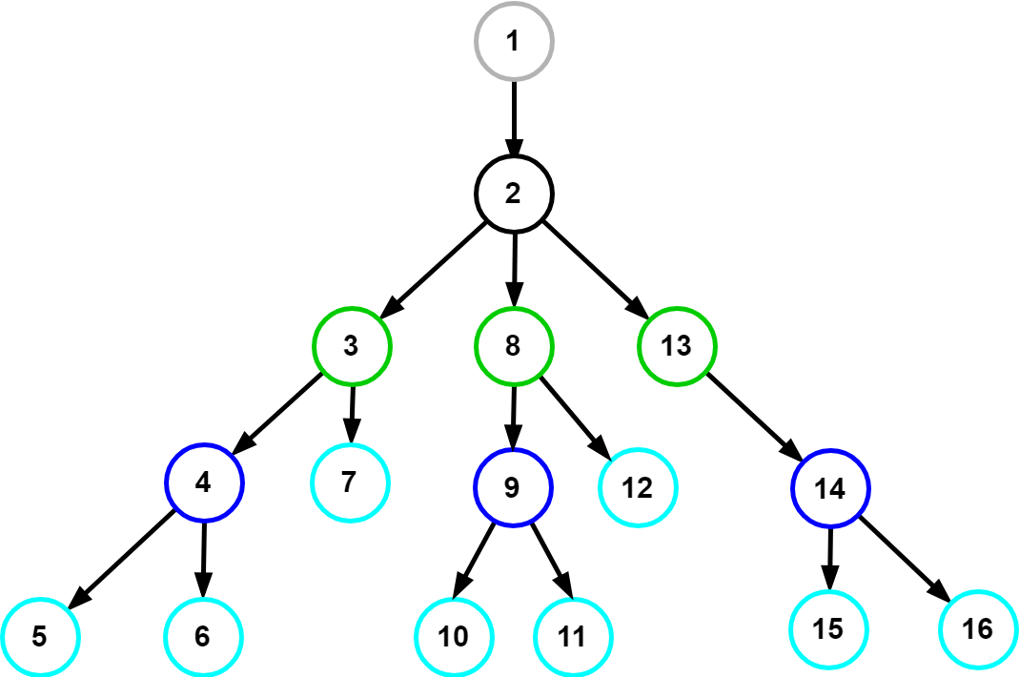
Database Queries Nodes Query - Solution
Query all after selection and filter afterwards in buildHierarchy function.
Selection
DB-Query
buildHierarchy
>= rootId
selected root
If ‘Legato’ root node selected, ask for another selection. If not, record rootId
Query all after selected root node id:
SELECT * FROM l_nodes
LEFT JOIN prj_prc_visu_vertices
ON node = parent
WHERE l_nodes.id >= rootId;
Starting from root node
Filter out non descendants of selected root node
Extract children of descendants via parent attributes.
Build hierarchy for root node and descendants.

Slide 9
Database Queries Connections Query
Complex SQL Query with LEFT JOIN
Workaround with javascript:
2 distinct queries
Left Join Function in javascript on common attribute
p_values_current
id [PK] : Int
value_bool : Int
value_num : Double
value_str : String
l_nodes
prj_prc_pro_flows
p_values_config
value_date : Timestamp
Wanted Query Data
id [PK] : Int
time_stamp : Timestamp
id [PK] : Int
last_archive_id : Int
visu_vertices
node0 : Int
connection : Int
node1 : Int
last_update : Timestamp
port0 : Int
value_type : Int
…
port1 : Int
value_format : Int
product : Int
value_symbol: String
p_value_types
is_continuous : Boolean
name_0: String
id [PK] : Int
rate_value : Int
name_1: String
name_0 : String
flow_type : String
…
name_1 : String
description_0 : String
LEFT JOIN
ON tree.id = vertex.node
description_1 : String
…

Slide 10
Nodes buildHierarchy()
flatArray
treeArray
buildHierarchy(flatArray)
Input
Output
Flat Array (hierarchical relations via parent attribute):
Tree Array (nested hierarchy via children attribute):
1 | 2 | 3 | 4 | 5 | 6 | 7 | 8 | 9 | 10 | 11 | 12 | 13 | 14 | 15 | 16
1 | 2 | 3 | 4 | 5 | 6 | 7 | 8 | 9 | 10 | 11 | 12 | 13 | 14 | 15 | 16

Slide 11
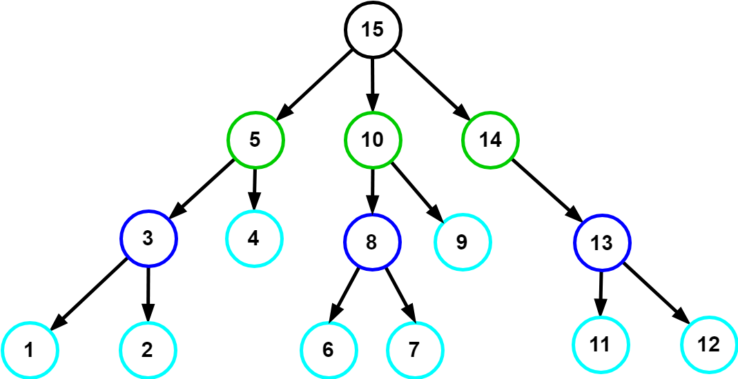
Nodes traverseAndSort()
nodeTree
path
(for vertex placement)
traverseAndSort(nodeTree)
Input
Output
Tree Array (nested hierarchy):
Path Array:
1 | 2 | 3 | 4 | 5 | 6 | 7 | 8 | 9 | 10 | 11 | 12 | 13 | 14 | 15 | 16
1 | 2 | 3 | 4 | 5 | 6 | 7 | 8 | 9 | 10 | 11 | 12 | 13 | 14 | 15 | 16

Slide 12
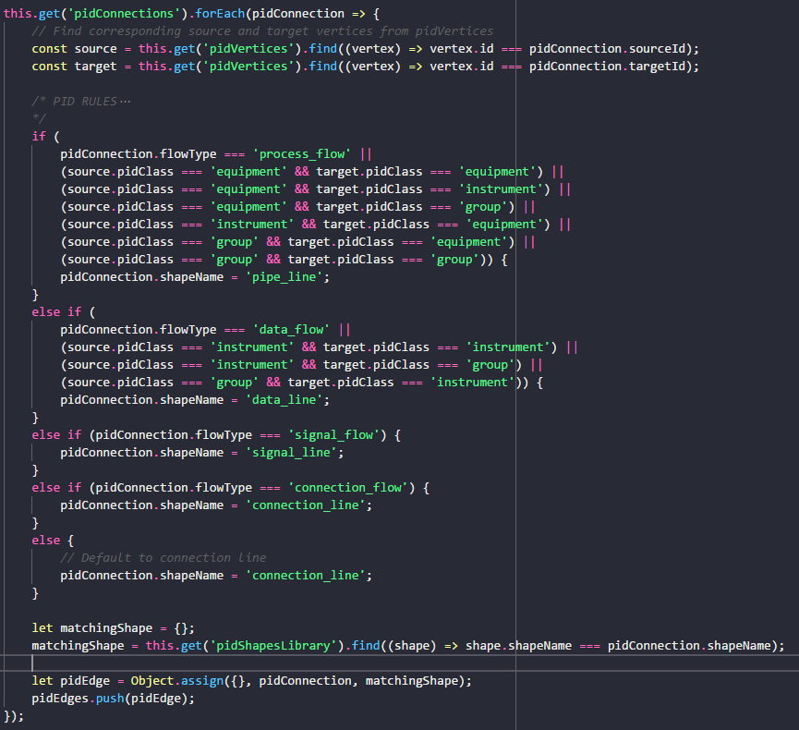
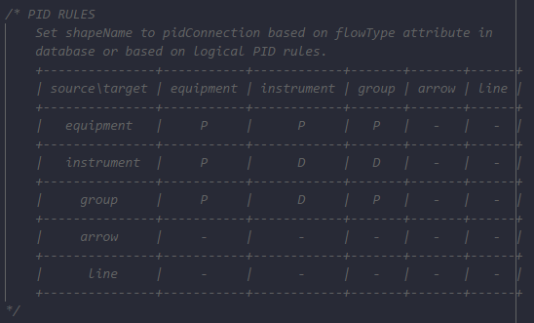
Connections mapConnectionsToShapes()
P&ID Rules to determine shapeName according to pidClass of source and target shapes of connection.
Rules as Adjacency Matrix:

Slide 13
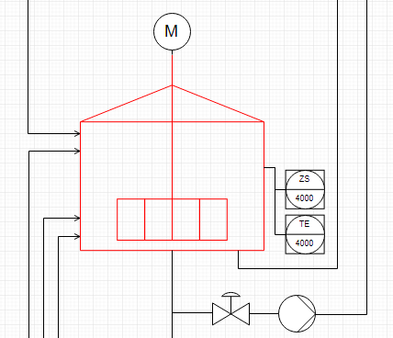
vertexPlacement() Concept
DFS Pathfinder traversal returns traversal path (ordered array of vertices)
Count units to construct general grid layout.
Implement Units and CModules as groups (containers) with mxGraph API.
Vertex placement inside group: square grid algorithm places nodes inside
Rules for example: if (valve to instrument) : instrument above valve
pidLevel to isaLevel map:
1 : Enterprise
2 : Site
3 : Area
4 : Process Cell
5 : Unit
6 : Emodule
…
n : Cmodule
(only last level labelled as Cmodule)
Enterprise : AIDA Cruises
…
Site : AIDA
…
Area : Brewery
…
Process Cell : Brewhouse
…
REMAKE WITH DRAW IO
Constructs grid layout as 2D-array
Units layed out inside each grid cell separately, units placed in grid at the end.
Unit : U_L2
13
U_M5
17
U_P3
…
…
EModule : Water_injection
6
Stem_ heating
12
14
15
16
…
…
…
…
…
…
…
…
…
…
…
Siblings (in level)
CModule :
1
2
3
4
5
7
8
9
10
…
…
…
…
…
…
Control_valve_440
Pump_P40
Motor
Kettle_sensor_Z
Kettle_sensor_T
11

Slide 14
vertexPlacement() 3 – placeVertices()
nodeTree
path
(for vertex placement)
placeVertices(path)
Input
Output
Tree Array (nested hierarchy):
Path Array:
1 | 2 | 3 | 4 | 5 | 6 | 7 | 8 | 9 | 10 | 11 | 12 | 13 | 14 | 15 | 16
1 | 2 | 3 | 4 | 5 | 6 | 7 | 8 | 9 | 10 | 11 | 12 | 13 | 14 | 15 | 16

Slide 15
vertexPlacement() Family Tree Analogy - Terminology
Path Array:
1 | 2 | 3 | 4 | 5 | 6 | 7 | 8 | 9 | …
Areas Array:
1 | 2
3 | 4
4
1 | 2 | 3 | 4 | 5
1 | 2 | 3 | 4 | 5
1 | 2 | 3 | 4 | 5
1 | 2 | 3 | 4 | 5
1 | 2 | 3 | 4 | 5
1 | 2 | 3 | 4 | 5
1 | 2 | 3 | 4 | 5
1 | 2 | 3 | 4 | 5
1 | 2 | 3 | 4 | 5

Slide 16
Vertex Placement Constraints
Constraints: provided as additional inputs to graphing algorithm
Knowledge about graph semantics required for example:
place a given vertex in the “middle” of the drawing
place a given vertex on the external boundary of the drawing
draw a subgraph with a prescribed “shape”
keep a group of vertices “close” together
1. Algorithmic Approach → For minimizing area
Graph layout generated according to a prescribed set of aesthetic criteria.
Aesthetic criteria in algorithm as optimizatioin goals (minimize crossings, minimize area …)
Advantages: computational efficiency
Disadvantages: user-defined constraints not naturally supported.
2. Declarative Approach → For vertex positioning
Graph layout specified by user-defined set of constraints.
Layout generated by the solution of a system of constraints.
Advantages: expressive power
Disadvantages: some natural aesthetics (e.g. planarity) need complex constraints, general constraint solving systems are computationally inneficient (think of many if-thens), lack of powerful language for constraint specification.
http://cs.brown.edu/people/rtamassi/papers/gd-tutorial/gd-constraints.pdf

Slide 17
Vertex Positioning Rules
Positioning Rules based on shapeCategory: (inline/block/center/nucleus tags. tiles system, declarative
current previous | agitators | arrows | compressors | heat exchangers | engines | flow sensors | filters | pumps | valve | group | instrument | vessel
agitators | - | - | - | - | 1 | - | - | - | - | 2 | - | 3
arrows | - | - | - | - | - | - | - | - | - | - | - | -
compressors | - | - | - | - | - | -
heat exchangers
engines
flow sensors
filters
pumps
valve
group
instrument
vessel

Slide 18
vertexPlacement() Algorithm Overview
forEach vertex in pidVertices:
if (not group):
calculate cell area
store cell area
position current vertex:
get previous vertex position (x, y values)
apply positioning rules
set current vertex position
update value of previous x, y values
else if (group):
sum areas of contained cells

Slide 19
Data Bindings Overview
User objects and metadata:
The User object is what gives mxGraph diagrams a context, it stores the business logic associated with a visual cell.
Can be simply a string or value and even an object.
mxGraph supports the process of populating the model on the server-side and transmitting to the client, and back again. See the later chapter on “I/O and Server Communication”.
The data transmitted will be both the visual model (the diagram) as well as the business logic (mostly contained in the user objects).
PID metadata of the cell (non mxGraph data) can be included here as key-value pairs.
Values are then accessible through the key via placeholders.
value:
Removed value attribute from mxCell (default is null) because it would override the binded object surrounding the mxCell.
When value attribute is omitted in mxCell, the object surrounding the mxCell is enabled.
placeholders:
Placeholders can be used in labels and tooltips to reference properties of cells or ancestors, including the properties of the diagram.
Must be enabled for all objects: set ‘placeholders’ attribute to ‘1’ or check the Placeholders option in the metadata dialog.
To reference a property in a label or tooltip, place the name of the property between % signs.
placeholder:
A special field called in the metadata of the cell that can be used to reference the value under the given name in the cell's or an ancestor's metadata.

Slide 20
Next Sprint – ToDos Weekly Sprint 10
Boardlet Design
Fix floating buttons (side-by-side)
Design of root-node-selection input field
Fix query of siblings when selecting one root node
Build Hierarchy Function
Fix to start from selected root node (to work out for multiple)
Database queries
Connect remaining tables to repository with LC2 (instructions in daily-routine notes)
getData() generic Function
pidRootNode name query (to display in input field on updateInput())
pidNodes query
pidConnections query
Process Variables query
Animations via sapient-bind
Documentation and Commenting
Modularization of code
JsDocs
Testing

Slide 21
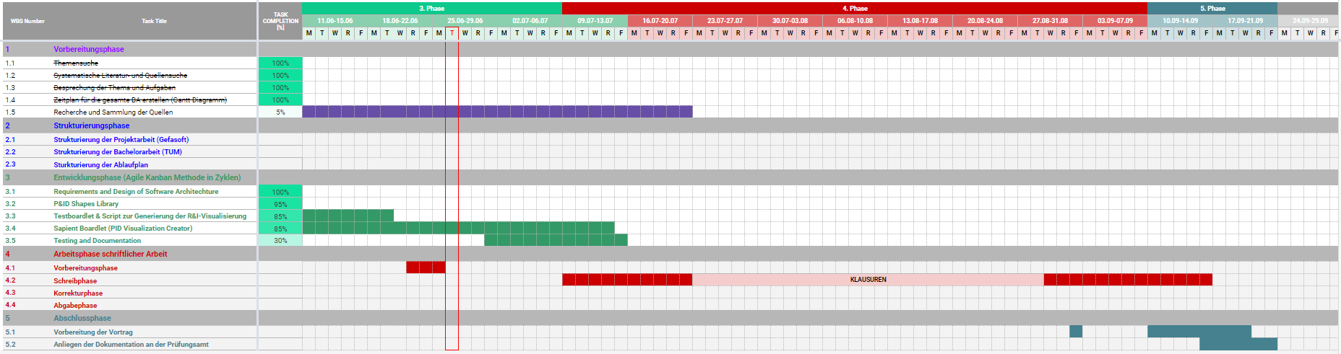
Project – Overview Overview of tasks: Week 10

